Slide 1
Maths
Unit 2 – Numbers and Sequences
WALT:
6Nc.04 – Use knowledge of square numbers to generate terms in a sequence given its position.
6Ni.08 – Use knowledge of multiplication and square numbers to recognise cube numbers.

Slide 2
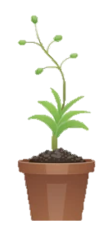
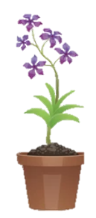

WALT: Use knowledge of square numbers to generate terms in a sequence given it’s position. Use knowledge of multiplication and square numbers to recognise cube numbers.
With support, I can answer questions about square and cube numbers.
Independently, I can answer questions about square and cube numbers.
I can complete the “Think Like A Mathematician” investigation.

Slide 3
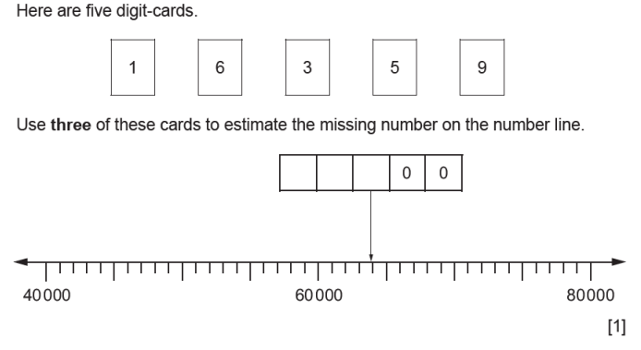
Retrieval Practice
WALT: Use knowledge of square numbers to generate terms in a sequence given it’s position. Use knowledge of multiplication and square numbers to recognise cube numbers.
6
3
9
70,000
65,000

Slide 4
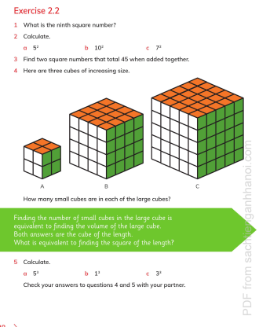
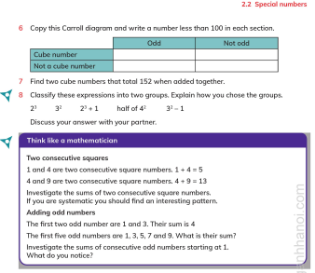
WALT: Use knowledge of square numbers to generate terms in a sequence given it’s position. Use knowledge of multiplication and square numbers to recognise cube numbers.
Pg. 28 - 29

Slide 5
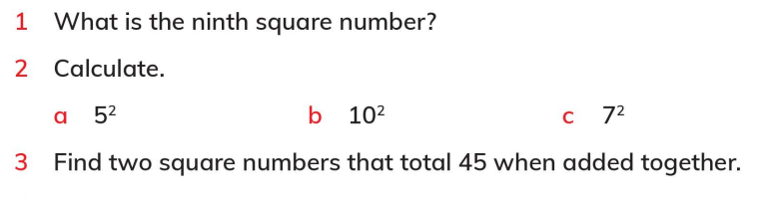
WALT: Use knowledge of square numbers to generate terms in a sequence given it’s position. Use knowledge of multiplication and square numbers to recognise cube numbers.
81
25
100
49
36 + 9

Slide 6
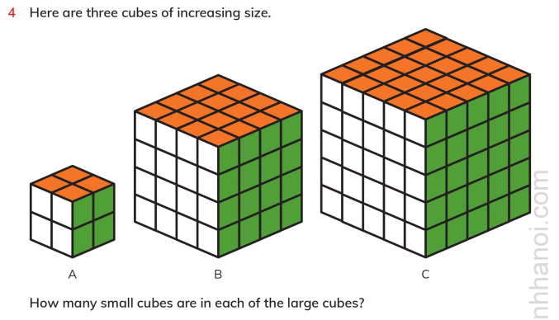
WALT: Use knowledge of square numbers to generate terms in a sequence given it’s position. Use knowledge of multiplication and square numbers to recognise cube numbers.
125
64
8

Slide 7
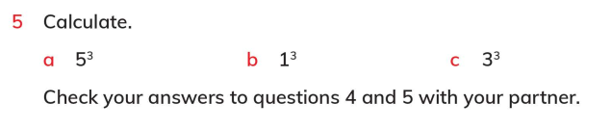
WALT: Use knowledge of square numbers to generate terms in a sequence given it’s position. Use knowledge of multiplication and square numbers to recognise cube numbers.
125
1
27

Slide 8
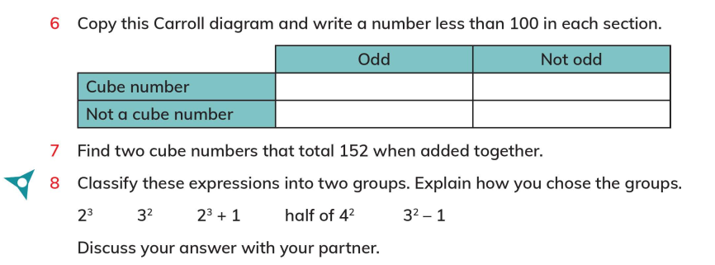
WALT: Use knowledge of square numbers to generate terms in a sequence given it’s position. Use knowledge of multiplication and square numbers to recognise cube numbers.
1 or 27
8 or 64
3, 5, 7 … 25, 29 …
2, 4, 6, 10 … 62, 66 …
125 + 27

Slide 9
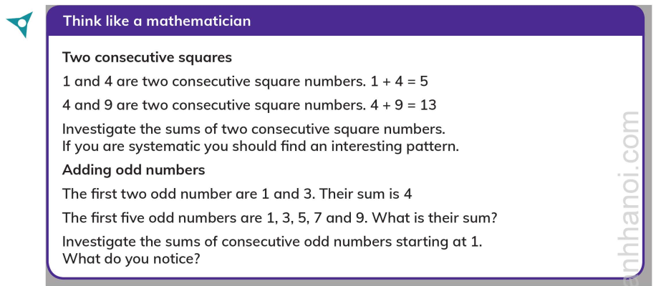
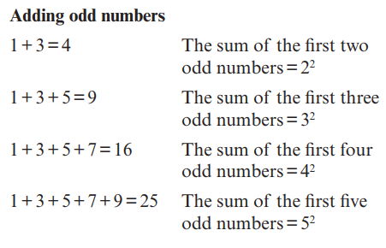
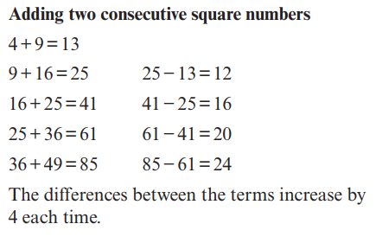
WALT: Use knowledge of square numbers to generate terms in a sequence given it’s position. Use knowledge of multiplication and square numbers to recognise cube numbers.

